Slide 1

Deployment, Configuration and Management of IT infrastructure based on Win server 2008 R2 SP1
Mentor: Mr. Alexandr Voronov | Yevgeniy Ten
Prakhar Sharma | Anshul Jain | Mumal Seth
Rupabh Tripathi |Harshil Tamrarkar

Slide 2

Windows Server 2008 R2 SP1
It is a server OS produced by Microsoft
It is the first 64-bit OS release
Helps to manage the remote computers efficiently
New functionality for Active Directory, new Virtualization and management features, version 7.5 of IIS
Designed to increase the reliability and flexibility of server infrastructure while helping save time and reduce costs
Support diff. types of users (normal, admin etc.) for better distribution of permissions
Arcelor Mittal uses corporative standard of this program
It provides both server and client virtualization, enabled by Hyper-V and Remote Desktop Services

Slide 3
Virtualization
Hyper V
Hyper-V is an integral part of Windows Server and provides a foundational virtualization platform.
With Windows Server 2008 R2 you get a compelling solution for core virtualization scenarios – production server consolidation, dynamic datacenter, business continuity, VDI and test & development.
Hyper-V provides you better flexibility with features like live migration and cluster shared volumes for storage flexibility.
Benefits
It contains everything needed to support machine virtualization.
Hyper-V enables IT organizations to reduce costs, to improve server utilization, and to create a more dynamic IT infrastructure.
Hyper-V provides the greater flexibility because of dynamic, reliable, and scalable platform capabilities combined with a single set of integrated management tools to manage both physical and virtual resources

Slide 4
Crux
We used two physical servers and installed two virtual machines HV-1 & HV-2 using hypervisor Hyper-V on the two servers respectively.
On HV-1 (192.168.1.1) we installed
Active Directory Server (ADS) + DHCP + DNS (192.168.1.3)
System Centre Configuration Manager (SCCM) (192.168.1.5)
On HV-2 (192.168.1.2) we installed
File Printer Sharing server (FPS) (192.168.1.6)
WEB + WDS (192.168.1.7)
Exchange Server (EXC) (192.168.1.4)

Slide 5
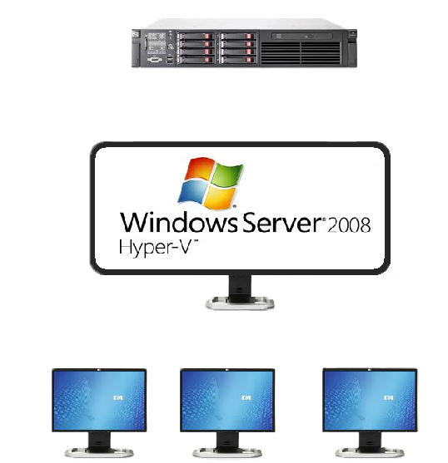
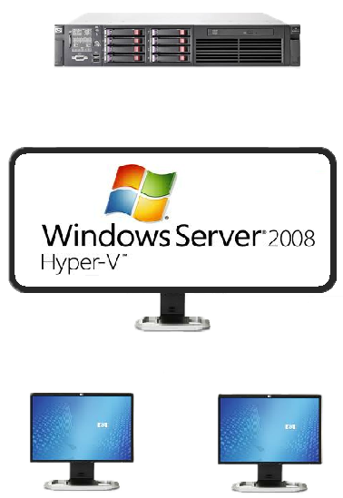
HV-1 → 192.168.1.1
HV-2 → 192.168.1.2
ADS
SCCM
EXC
FPS
WDS
192.168.1.3
192.168.1.5
192.168.1.4
192.168.1.6
192.168.1.7

Slide 6
ADS
Installed a win server 2008 R2 SP1 on Hyper V for ADS.
Installed Active Directory Domain Services and DHCP roles
Made an organizational unit (OU) ‘Finance’ in ADS
Made ‘Domains Users’ and added computers to the domain simultaneously editing the name and domain of the computers to be added
Also enabled Remote Desktop connection on other servers for Remote Desktop Access

Slide 7
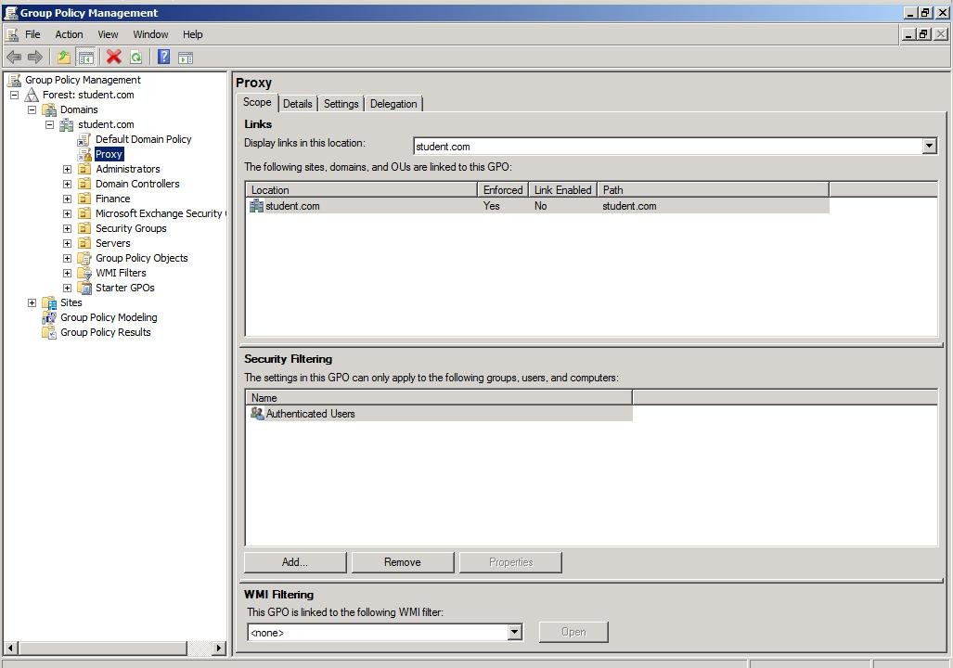
ADS forest

Slide 8
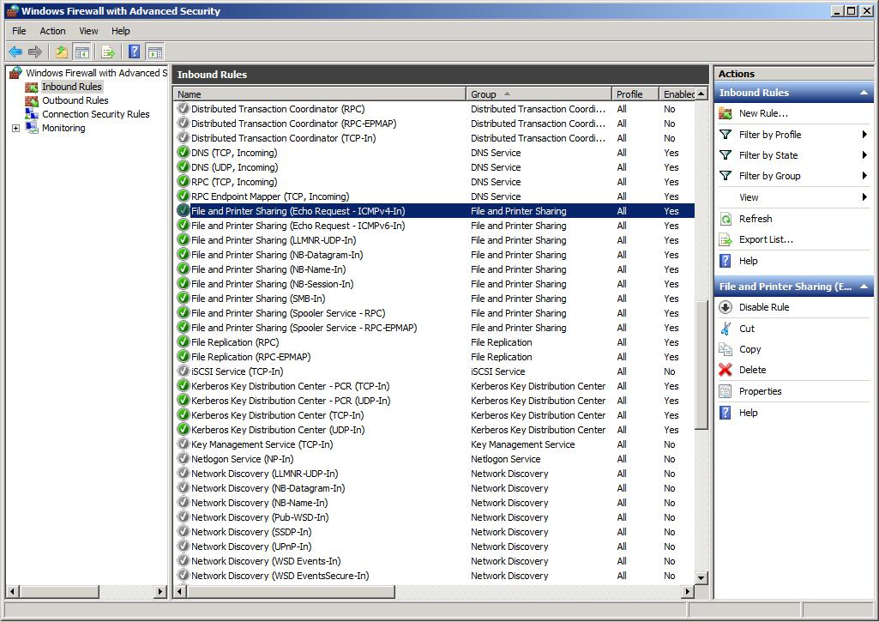
ADS contd…
In order to make the clients and servers ping each other we altered the inbound rules of the firewall as follows:
Firewall -> Inbound rules -> FPS (ICMPv4 -In) -> we enable this rule and assign ‘Any’ attribute to different features

Slide 9
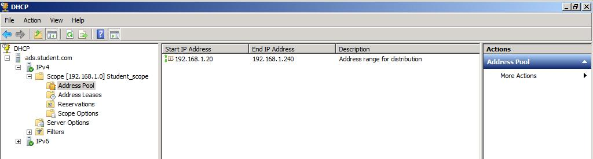
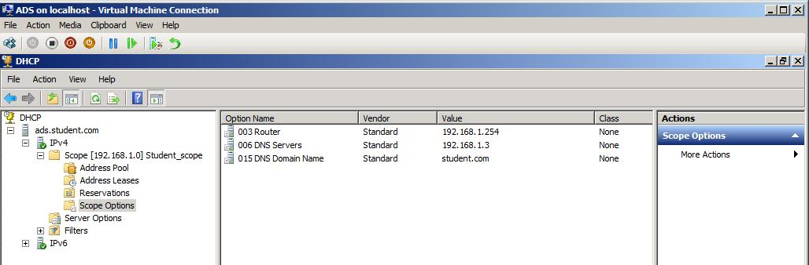
DHCP
Advantages of DHCP
Shows diff. computers on the network
Shows the DNS address
Helps in time allocation
Dynamic allocation of IP
In DHCP management console we assigned the scope of IP as 192.168.1.20 to 192.168.1.240
Assigned gateway as 192.168.1.254

Slide 10
DNS
Domain Name Server (DNS) is used for IP address resolution from names
We used two DNS, namely 192.168.1.3 and 8.8.8.8 (google public DNS)

Slide 11
Group Policy on ADS
Feature that controls the working environment of user accounts and computer accounts & provides the centralized management
Active Directory can distribute GPOs (group policy object) to computers that are part of a Windows domain.
We made two policies namely ‘Firewall’ and ‘Proxy’ apart from the ‘default domain policy’
Policy ‘Firewall’ and ‘Proxy’ was applied to student.com (highest position of hierarchy) by which we ensured that this GPO was applied to all the OU under the domain student.com

Slide 12
Group Policy on ADS contd…
To locate Group policy preferences:-
Run gpmc.msc
In the GPMC (group policy management console) tree, expand group policy objects in the forest and domain containing the GPO that you want to edit.
Right-click the GPO that you want to edit, and then click Edit.
In the console tree > expand Computer Configuration or User Configuration > expand Preferences > expand or click items as needed
Click an item in the console tree to view the associated settings in the details pane.

Slide 13
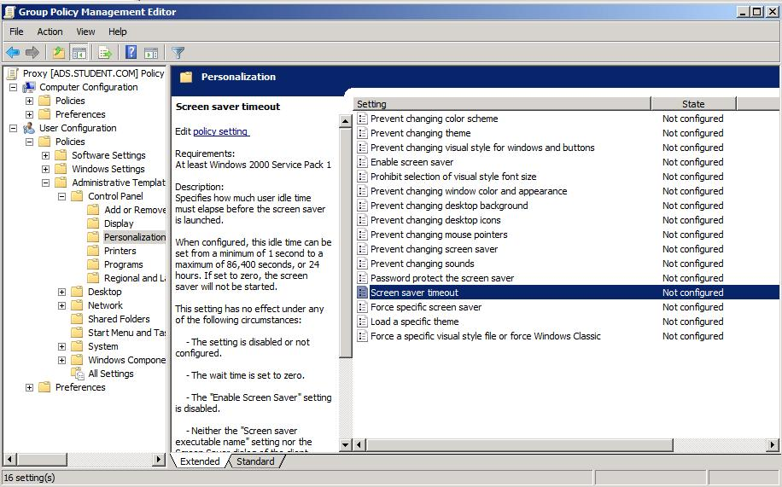
Group Policies Implementation
Screen Saver Timeout - Specifies how much user idle time must elapse before the screen saver is launched.
User Configuration\Administrative Templates\Control Panel\Personalization

Slide 14
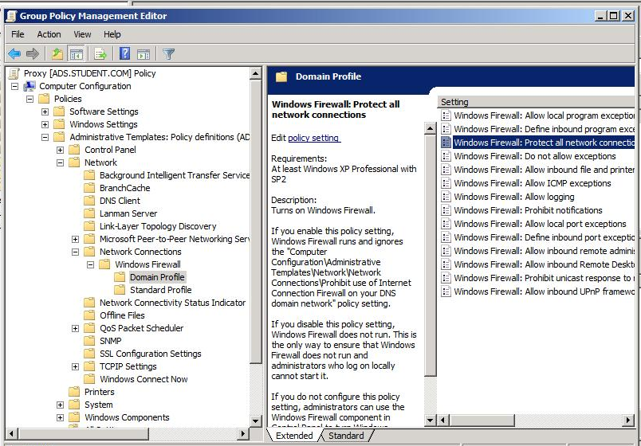
Group Policies Implementation
Firewall Disable/Enable – helps in managing the firewall settings on client computers in domain
Computer Config > Administrative Templates > Network > Network connections > Windows Firewall > Domain Profile > Windows Firewall: Protect all network connections = Disabled
After that either reboot the client machine or run “gpupdate /force” in cmd to apply the update group policy without restarting

Slide 15
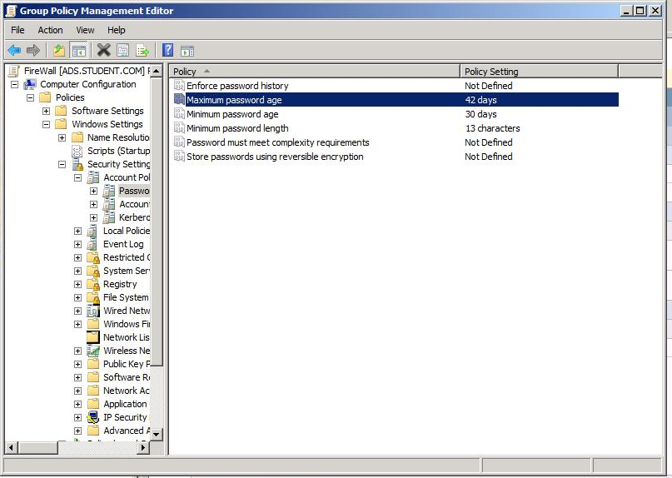
Group Policies Implementation
Password policy- by this one can change the max, min. age of password, length of password etc. to enforce it, go to gpmc.msc
Computer Configuration > Policies > Windows Settings > Secirity Settings > Account Policies > Password Policy

Slide 16
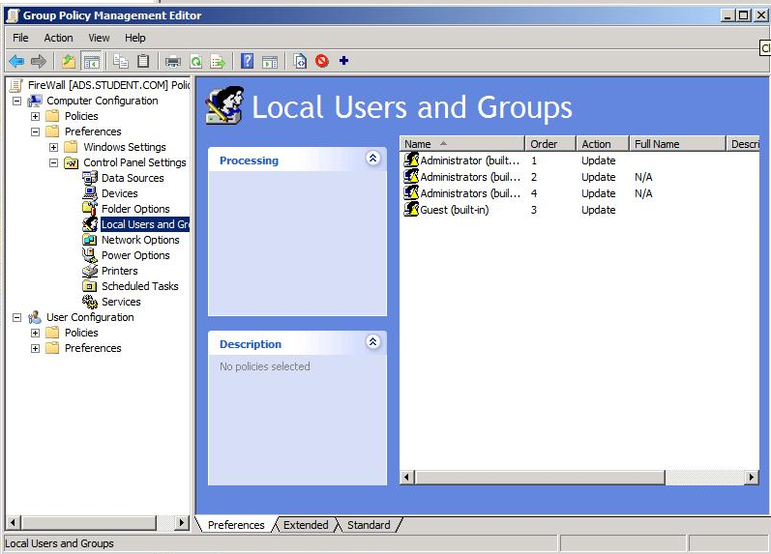
Group Policies Implementation
Policy for local admins- by this we enforced the policy by which local administrators can’t login on student domain without password
Computer Configuration > Preference > Control Panel Settings > Local User and Groups . Here you can add the local administrator for whom you want to enforce the password.

Slide 17
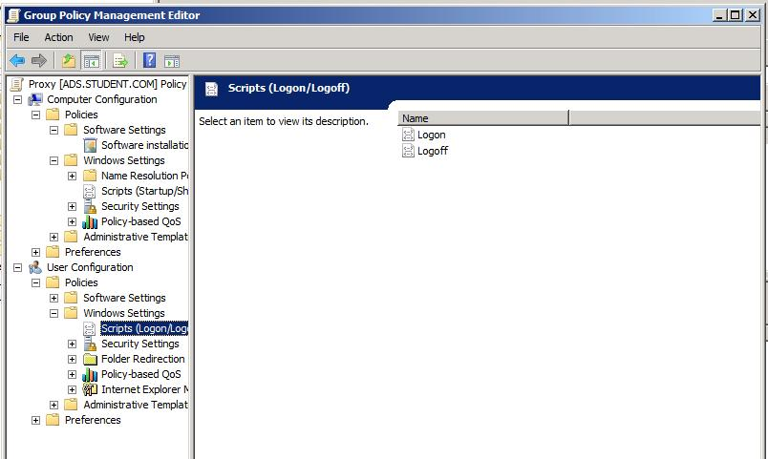
Group Policies Implementation
Deployment of Printers using VBS script – it helps to deploy required printers automatically by adding a VBS script in the group policy
in the gpmc , edit the gpo “proxy” , go to User Configuration > Windows Setting > Scripts > Logon and add the vbs script here

Slide 18
Exchange Server 2010
Microsoft Exchange Server is the server side of a client–server, collaborative application product developed by Microsoft.
It works with IMAP and HTTPS on a very protected policy. All info goes by IMAP and it’s difficult to be hacked , but if you are admin you can see everything.
What makes it most powerful is the cluster system, for e.g- You can have two servers but make it into one cluster and use it as one server
If we use exchange server 2010 then outlook shouldn’t be less than 2007

Slide 19
Exchange Server 2010 contd…
Installed a win server 2008 R2 SP1 on Hyper V for Exchange Server 2010.
Installed roles “Web server (IIS)” and “ File Services”
A user EXCadmin was created in Servers under student.com in ADS and EXC computer was added in computers section in servers in ADS.
We then run ‘Prerequisite checker’ of Exchange Server 2010.
We resolved the errors by applying Hotfix updates KB983440, KB979744, KB982867, KB977020

Slide 20
Exchange Server 2010 contd…
Before installation of exchange server we extended the schema on ADS for exchange server as follows:-
Go to ADS > run > “path where exchange server installation is present”\setup.com /preparead/organizationname:”student”
We started with the installation of exchange server 2010 with the necessary settings during the installation.
After the installation, in Microsoft exchange console, in recipient configuration we added a mailbox for ‘testuser’ by right clicking and adding the mailbox with necessary settings. Also we can add mailbox for existing users.
NOTE: If the user is not already been added in domain and a mailbox for him/her is created than automatically that user is created in the domain.
Notes:
We can edit the policy on the size of the mail that can be sent and also the size of the mailbox
For ex- user can have max size of mailbox as 500 mb for VIP and 200 mb for normal users

Slide 21
Configuring OWA
In order to access the outlook client from the client computer, do the following :-
Open a web browser and in the address bar type https://exc.student.com/owa or https://192.168.1.4/owa
OWA stands for Outlook Web App, by this one can open his mailbox and can send and receive mail.
To send a mail, add recipient as username@domain.com like excadmin@student.com

Slide 22
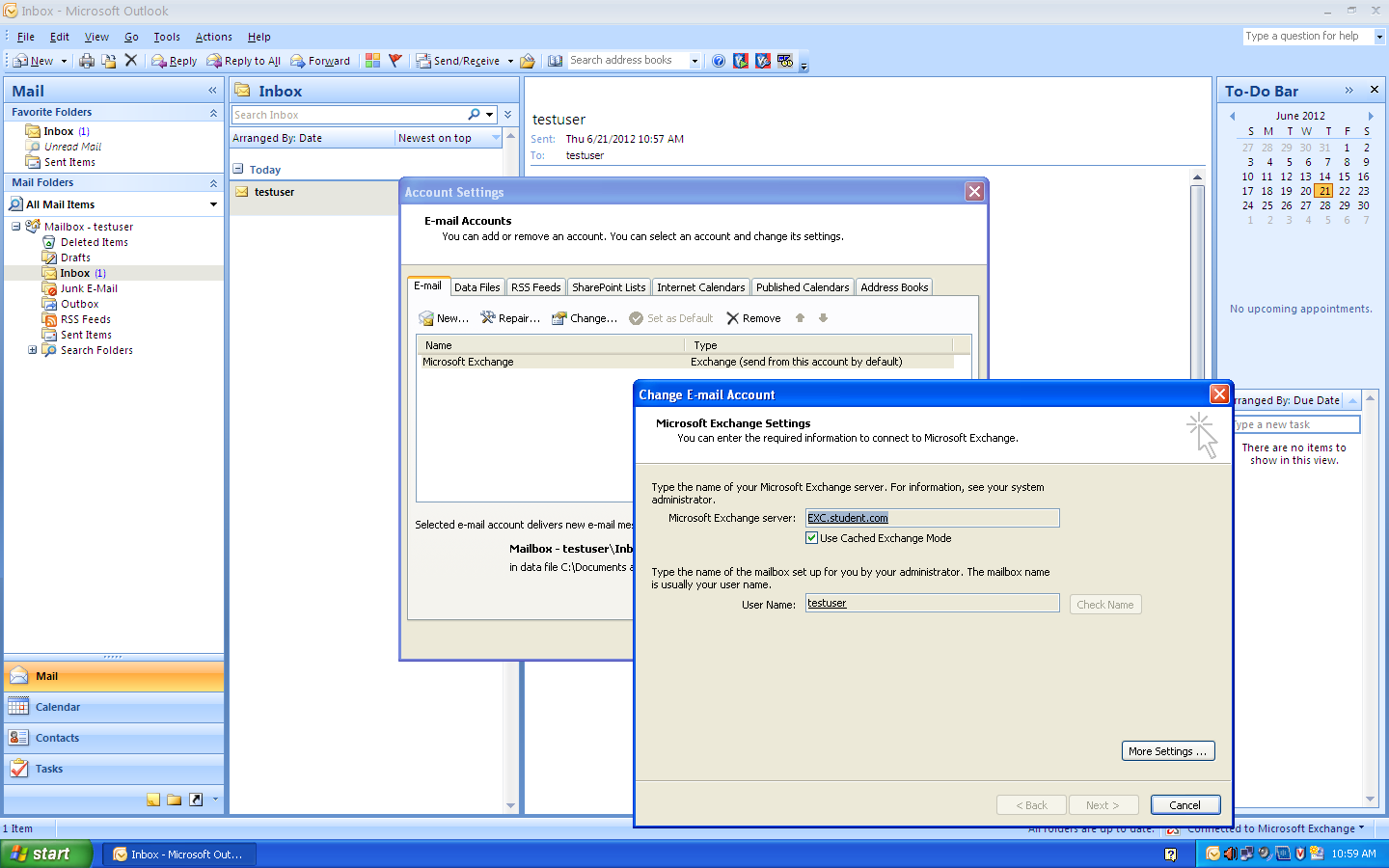
Configuring Outlook

Slide 23
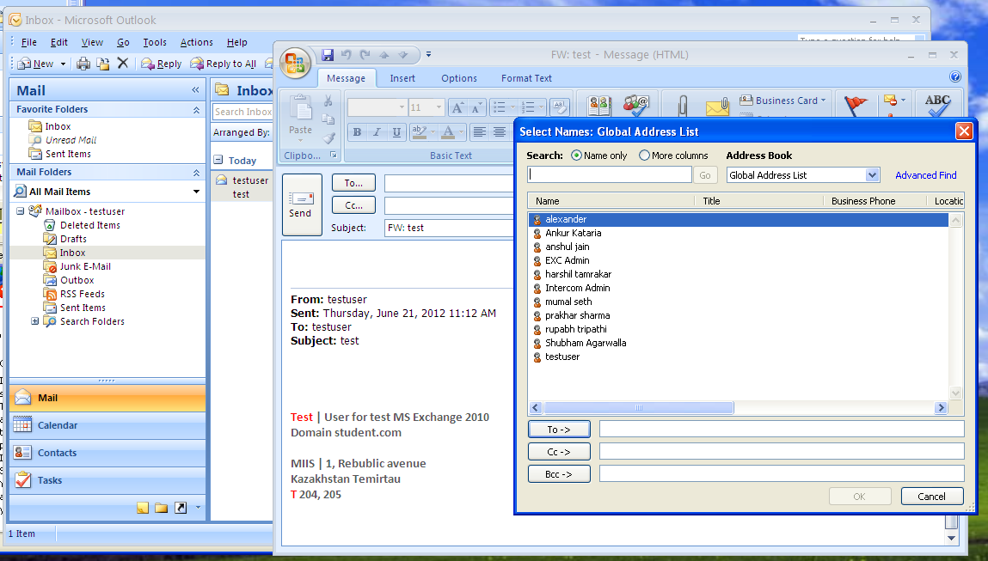
Global Address list of Outlook used for sending mail

Slide 24
File and Printer Sharing
Print Management provides print details about status of printers and print servers on the network
Used to install printer connections to a group of client computers simultaneously and to monitor print queues remotely
We installed a Windows server 2008 R2 SP1 for FPS server on 192.168.1.6
We then added roles File Services , File Server Resource Manager and Print Services in the server Management console

Slide 25
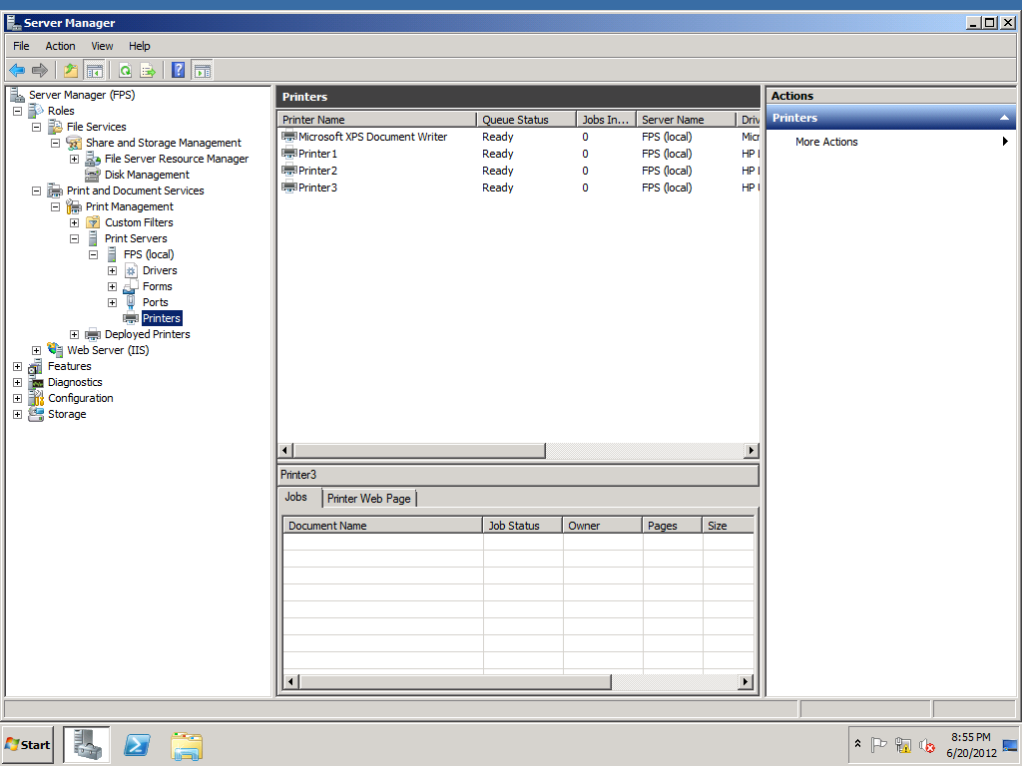
File and Printer Sharing
Adding new printer
Right Click and select
add printer
Select Add a TCP/IP
or Web Services Printer by
IP address or host name
Select TCP/IP devices and
enter IP and name
4. Click Next
5. Then it asks for Printer details
6. Click Finish

Slide 26
File and Printer Sharing
To modify permissions of a shared folder in Share and Storage Management
Right-click on the folder then select Properties. Select the Permissions tab and then click on Share Permissions
You can select a group or user that already has permissions defined for the share and then modify their permissions. Select a group or user and click Remove to stop assigning share permissions to it.
To define permissions for another group or user click Add, the standard dialog box for selecting users appears.
Click NTFS Permissions, a dialog box appears however note that there are four additional types of permissions available and there is also an Advanced button.
Click on Advanced to view the Advanced Security dialog box.
Select a permission entry from the list visible on the Permissions tab, and then click Edit. You can see that there are fourteen different permissions that are more precise than what is visible in the standard NTFS permissions dialog box.
Click the Owner tab to configure the owner of the folder. To change the owner select an account from the list and click Apply. The ability for users who belong to the Administrators group to seize ownership can be very useful, for example, when an employee leaves the firm an administrator can take ownership of the user’s data and grant permission to their supervisor.

Slide 27
FPS contd…
The publicly shared folder ‘Finance’ was restricted to folder size of 100KB. Also we restricted the types of files that the folder could contain.
After new file settings are applied, the already existing files of that corresponding type remain unaltered

Slide 28
SCCM
Microsoft System Center Configuration Manager helps you to empower people to use the devices and applications they need to be productive, while maintaining corporate compliance and control.
It accomplishes this with a unified infrastructure that gives a single pane of glass to manage physical, virtual, and mobile clients.
Provides tools and improvements that make it easier for IT administrators to do their jobs.
provides a comprehensive solution for change and configuration management for the Microsoft platform, enabling organizations to provide relevant software and updates to users quickly and cost-effectively.

Slide 29
Collecting H/W and S/W inventory
Distributing & installing S/W applications
Distributing & installing updates to S/W
eg: security fixes
Track Database growth in SQL Server databases
BENEFITS OF SCCM
Deploying
Operating System
Remotely controlling computers to provide troubleshooting support
By an affordable comprehensive IT management solution
Metering
software usage
Gain visibility into your IT environment

Slide 30
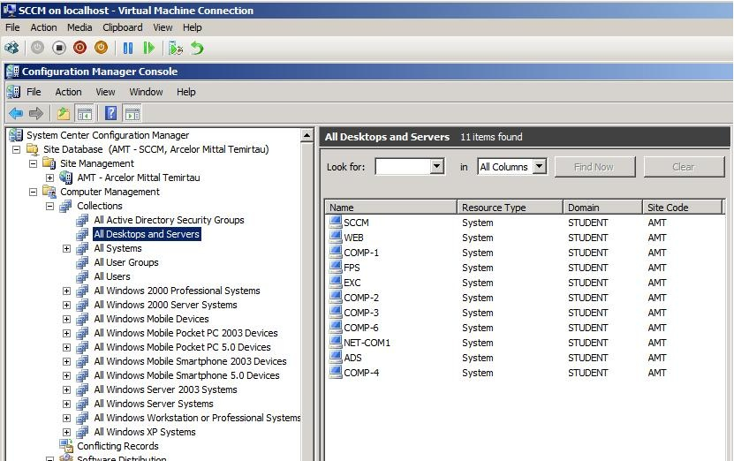
SCCM
A view of all the systems
in the domain

Slide 31
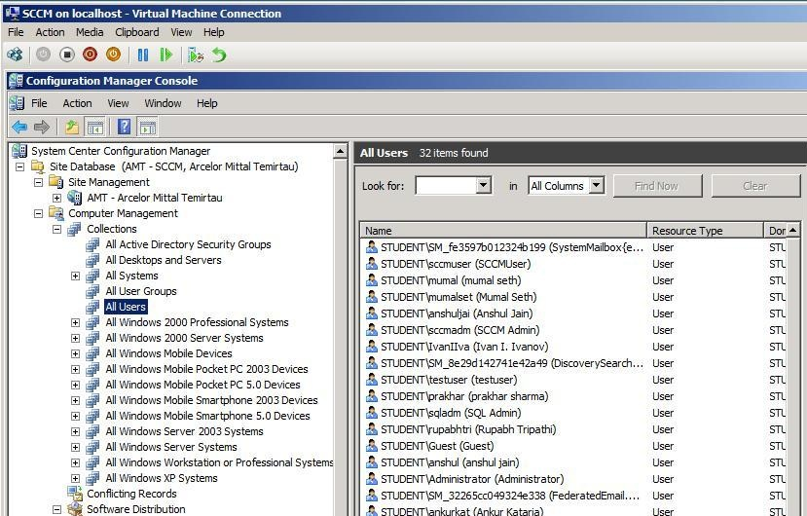
SCCM contd…
A view of all the users in the domain

Slide 32
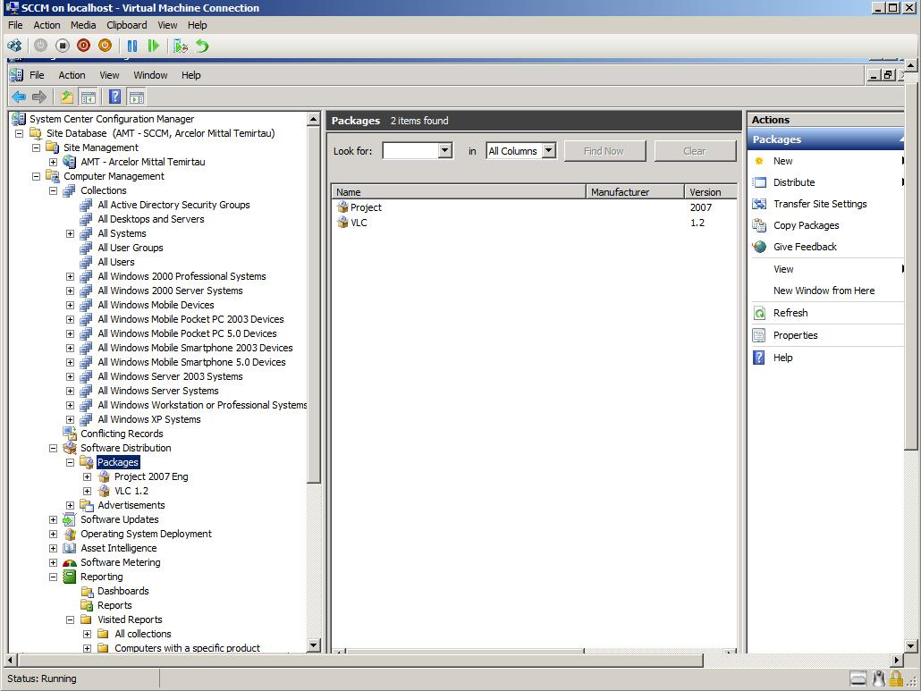
SCCM contd…
Adding packages to the local systems through the SCCM server

Slide 33
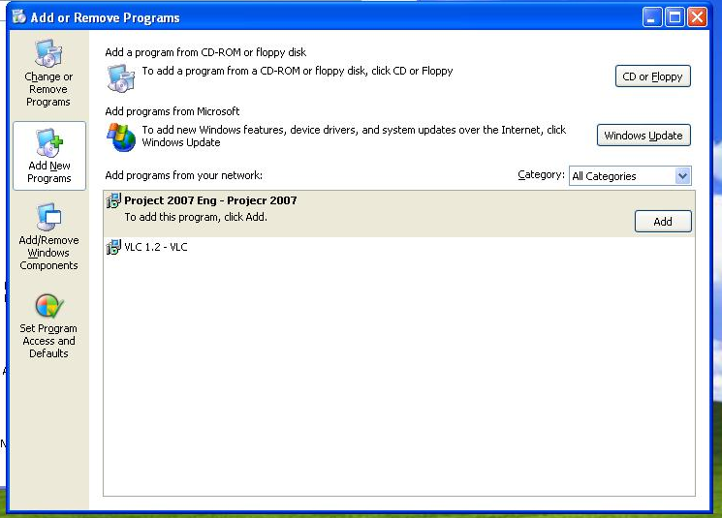
SCCM contd…
Packages installed in the local systems.

Slide 34
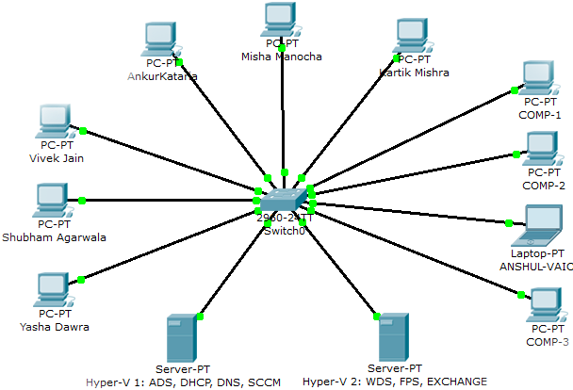
Schema of SCCM connection
NETWORK ADMINISTRATORS
VOICE INFRASTRUCTURE TEAM
DOMAIN USERS

Slide 35
WDS
We installed a Win server 2008 R2 SP1 for web server on 192.168.1.7
We then added roles WDS (windows deployment services) and IIS (Internet Information Service)
In server manager
Windows Deployment Services > Servers > WEB.student.com > Boot images , then right click on the boot image and select add boot image
Now boot image is loaded inside the boot image folder and similarly the install image in install image folder.
Now on the client machine , we choose the option to boot from the LAN , i.e use install image from web server (192.168.1.7)
Also in the menu , we get prompted to select the OS we want to install (in case there are more than one install images on the server)
Suppose inadvertently someone remove some software , pre-installed with the windows then in order to avoid the overhead of installing the entire OS again, we can create a capture image.

Slide 36
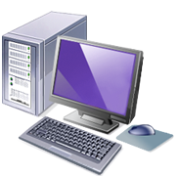

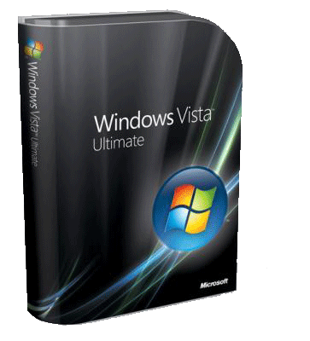
WDS contd…
To create a capture image , right click on boot image and create capture image with necessary details and install.
WDS

Slide 37
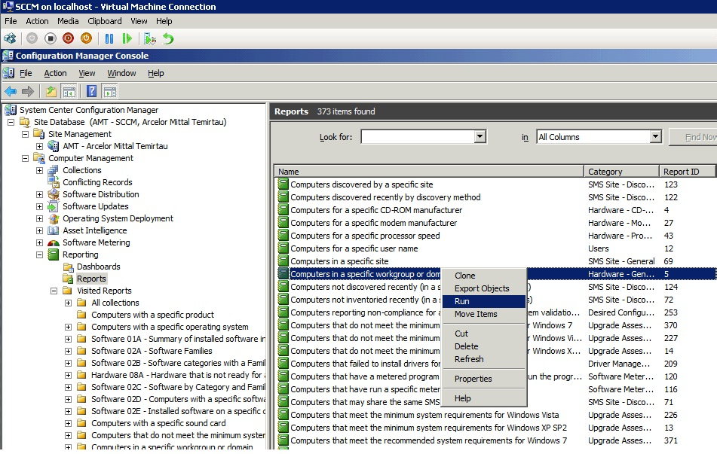
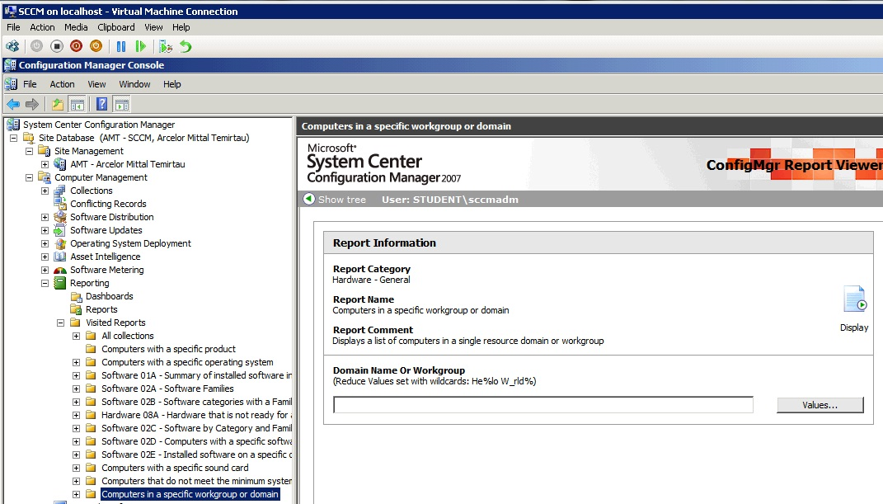
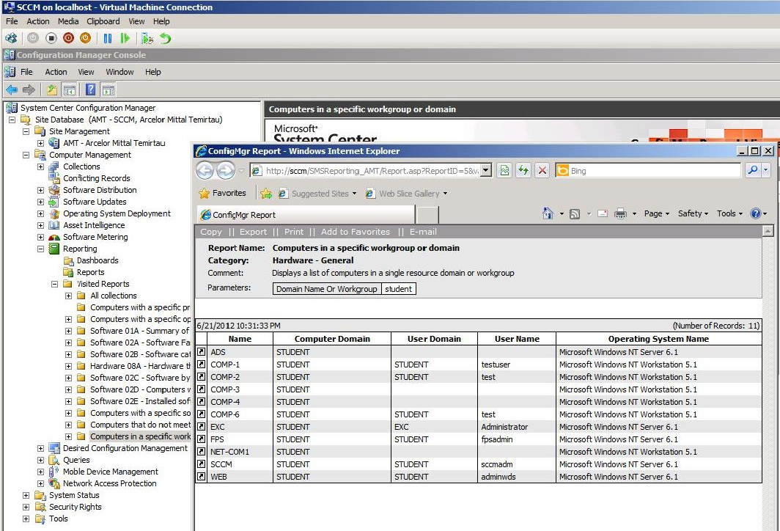
student

Slide 38
☺ Thank You ☺
Questions?

